Slide 1
Qaoss Installation and Configuration

Slide 2
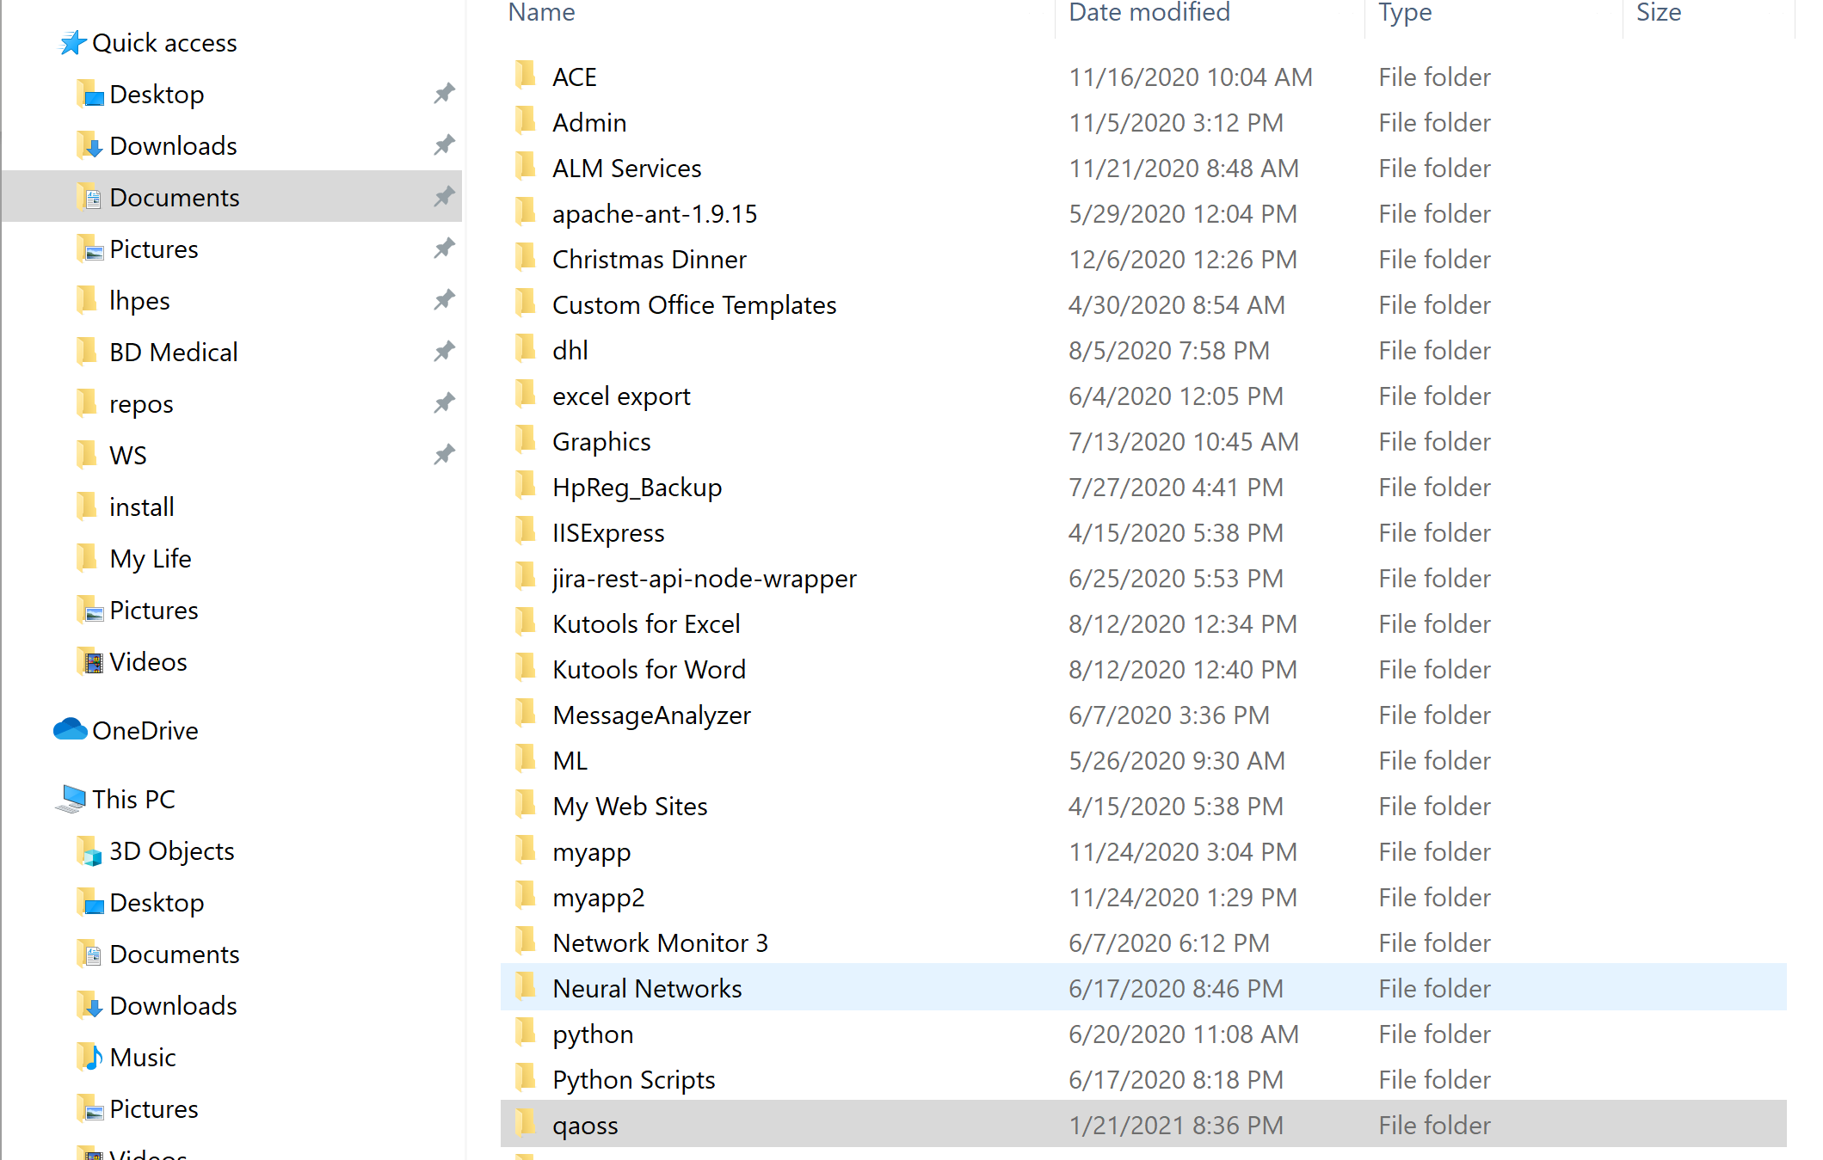
Unzip and copy the entire qaoss folder and all its contents to a folder on your local computer where you have full access. The "documents" folder works nice.

Slide 3
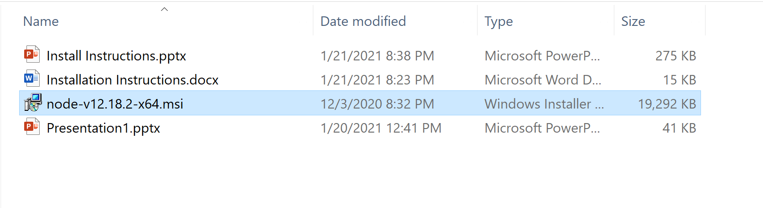
Double click to run the node-v12.18.2-x64.msi installation program in the qaoss\install folder. Accept all the default settings.

Slide 4
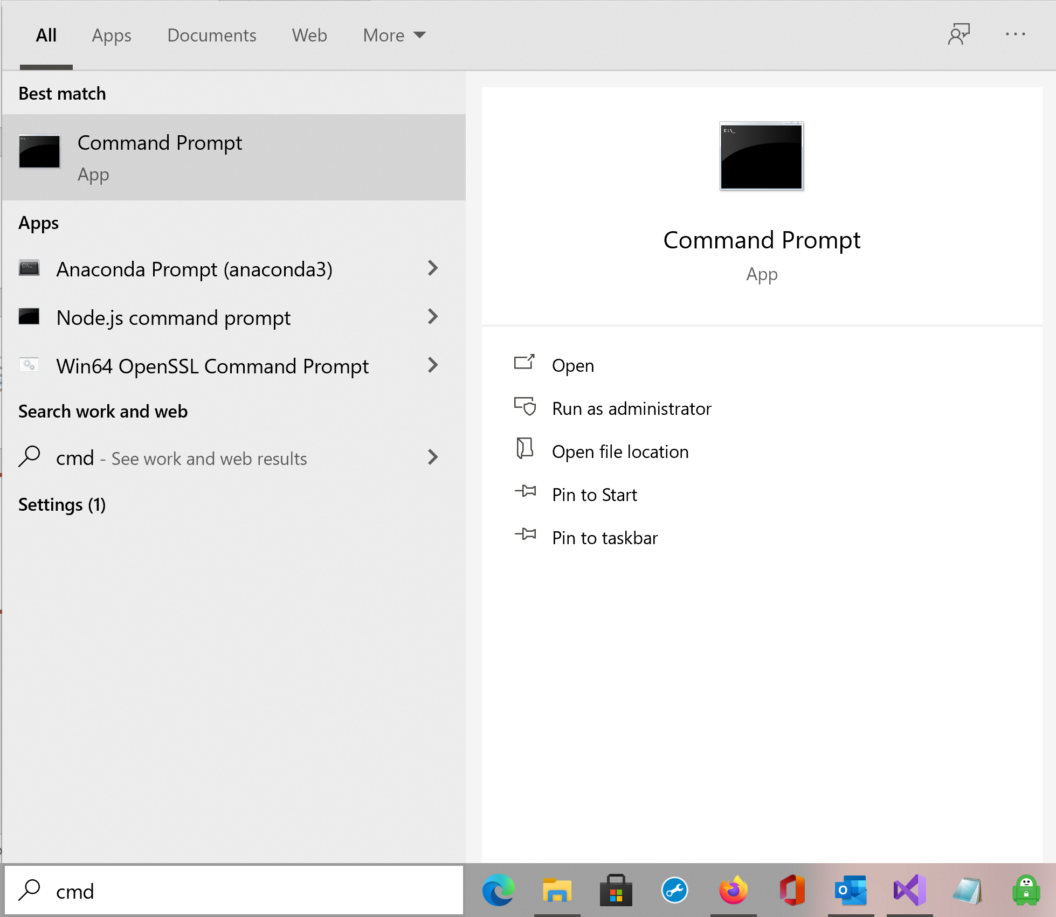
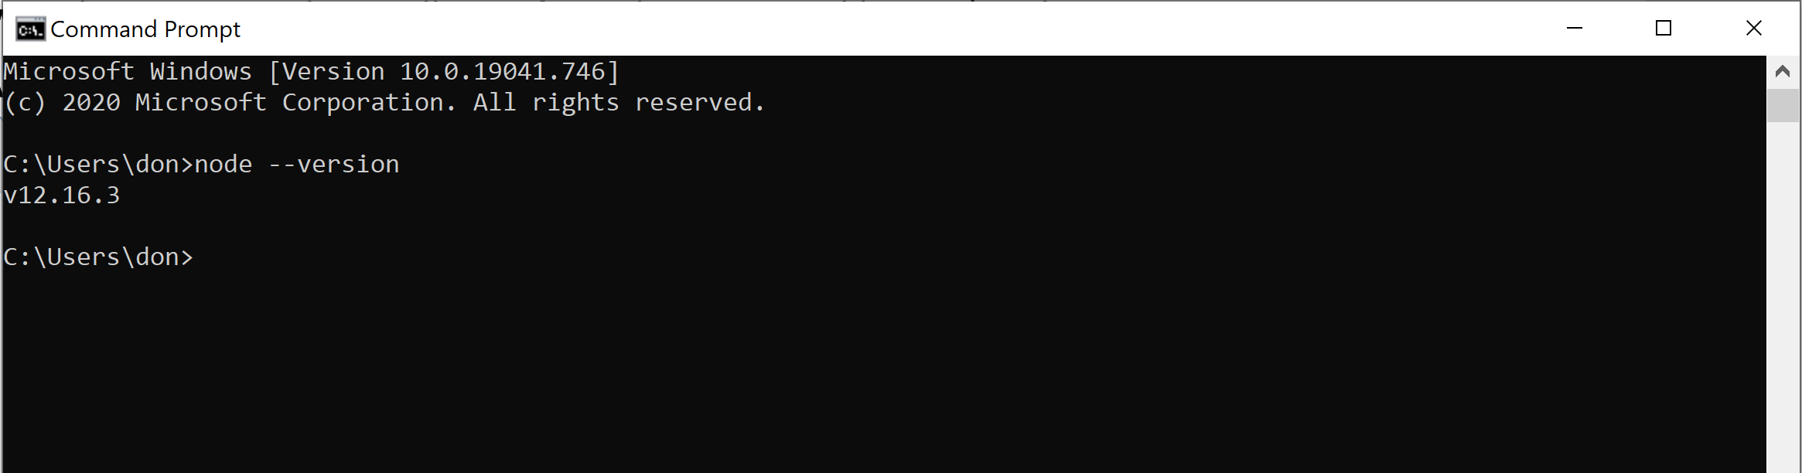
Open a dos window and test your node installation from the command line by typing: C:\node --version
It should show: v12.16.3

Slide 5
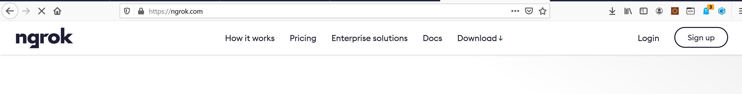
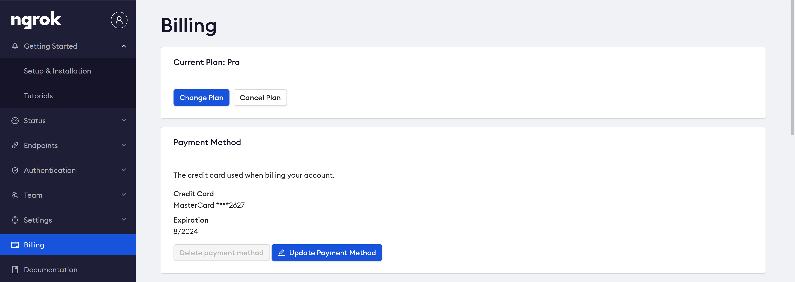
Sign up for an Ngrok account at https://dashboard.ngrok.com/signup.
Then go to the billing page.

Slide 6
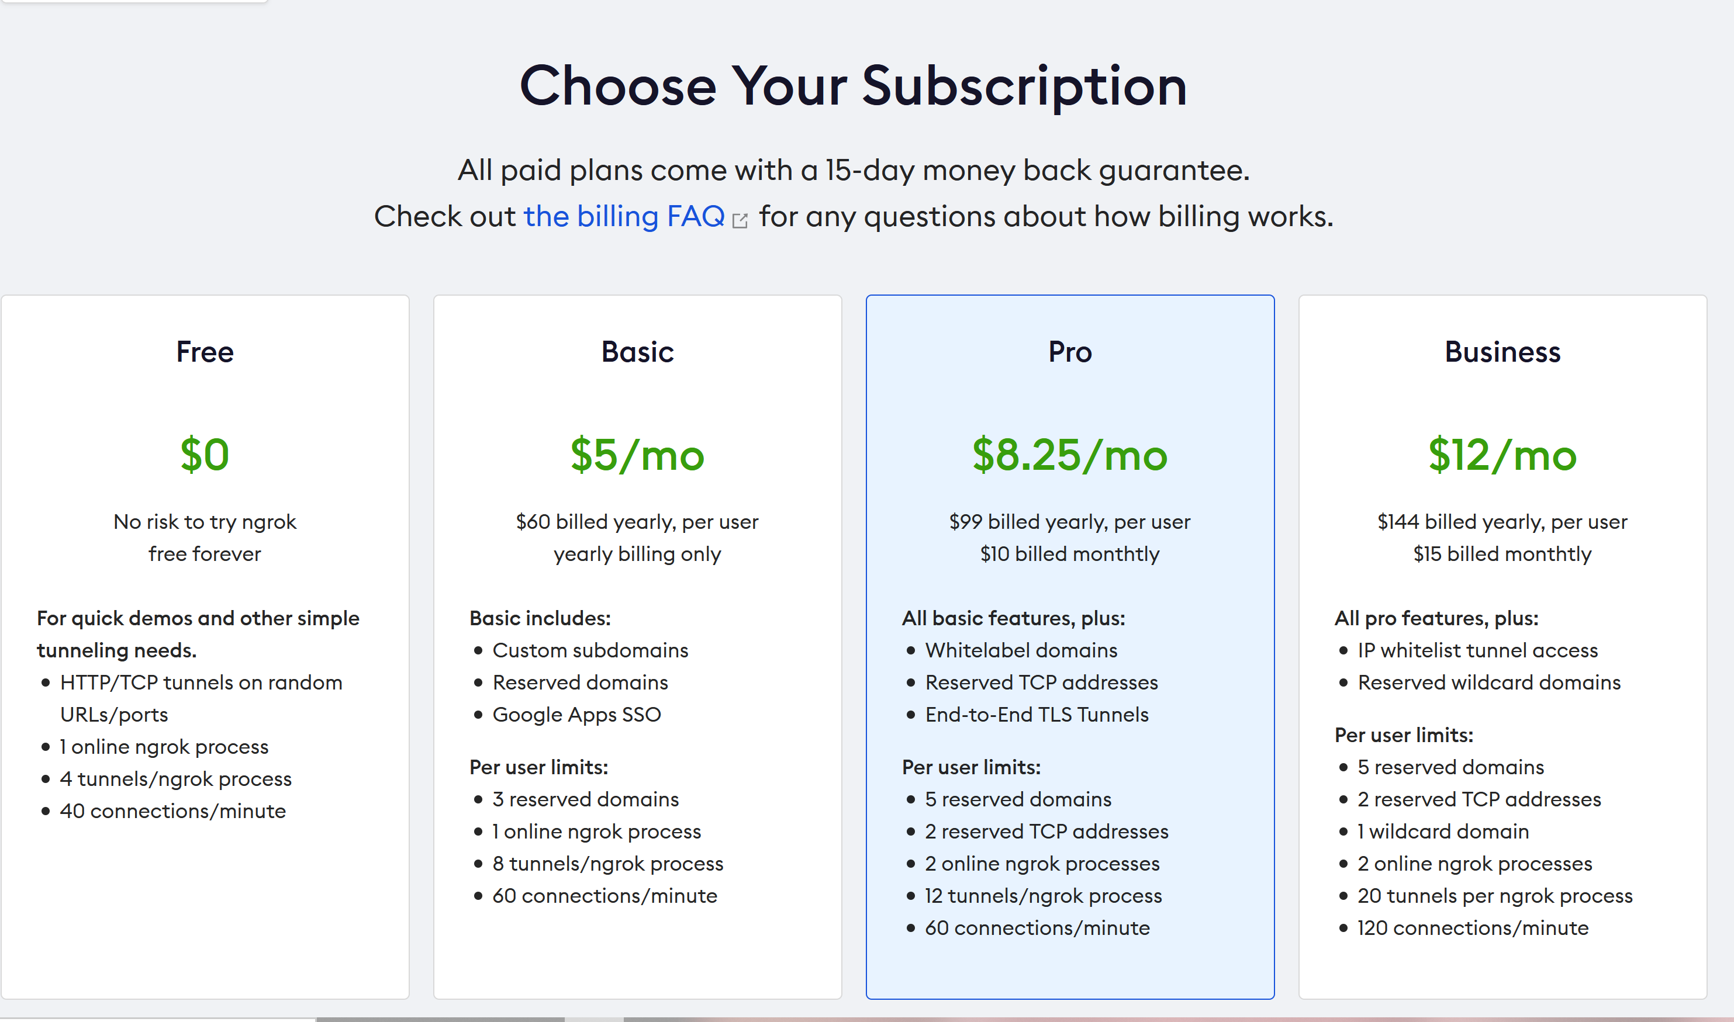
Sign up for a ‘Basic’ account. It's $5/month.

Slide 7
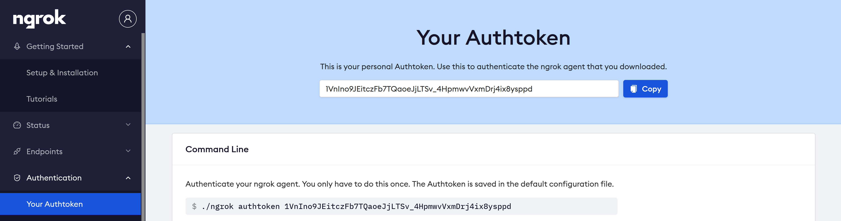
Once you're signed up Ngrok will provide you with an authentication token under the ‘Authentication/Your Authtoken’ link in the menu on the left. It’s just a long alphanumeric ID.

Slide 8
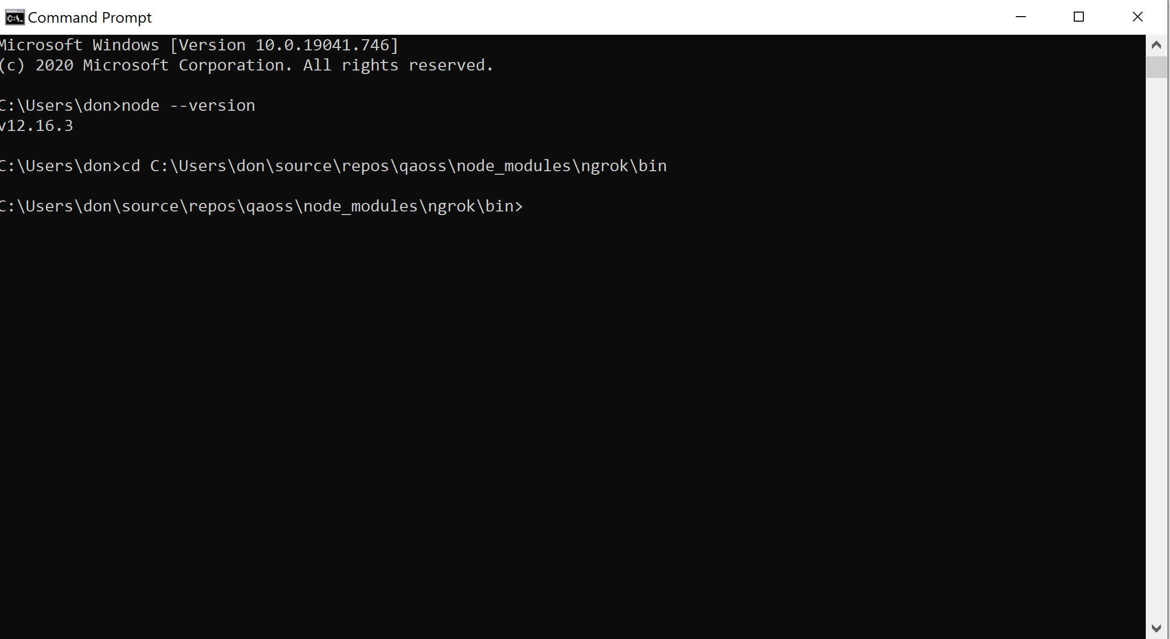
Open a dos window again and go to the “C:\(folder where you copied qaoss files)\qaoss\node_modules\ngrok\bin” folder.

Slide 9
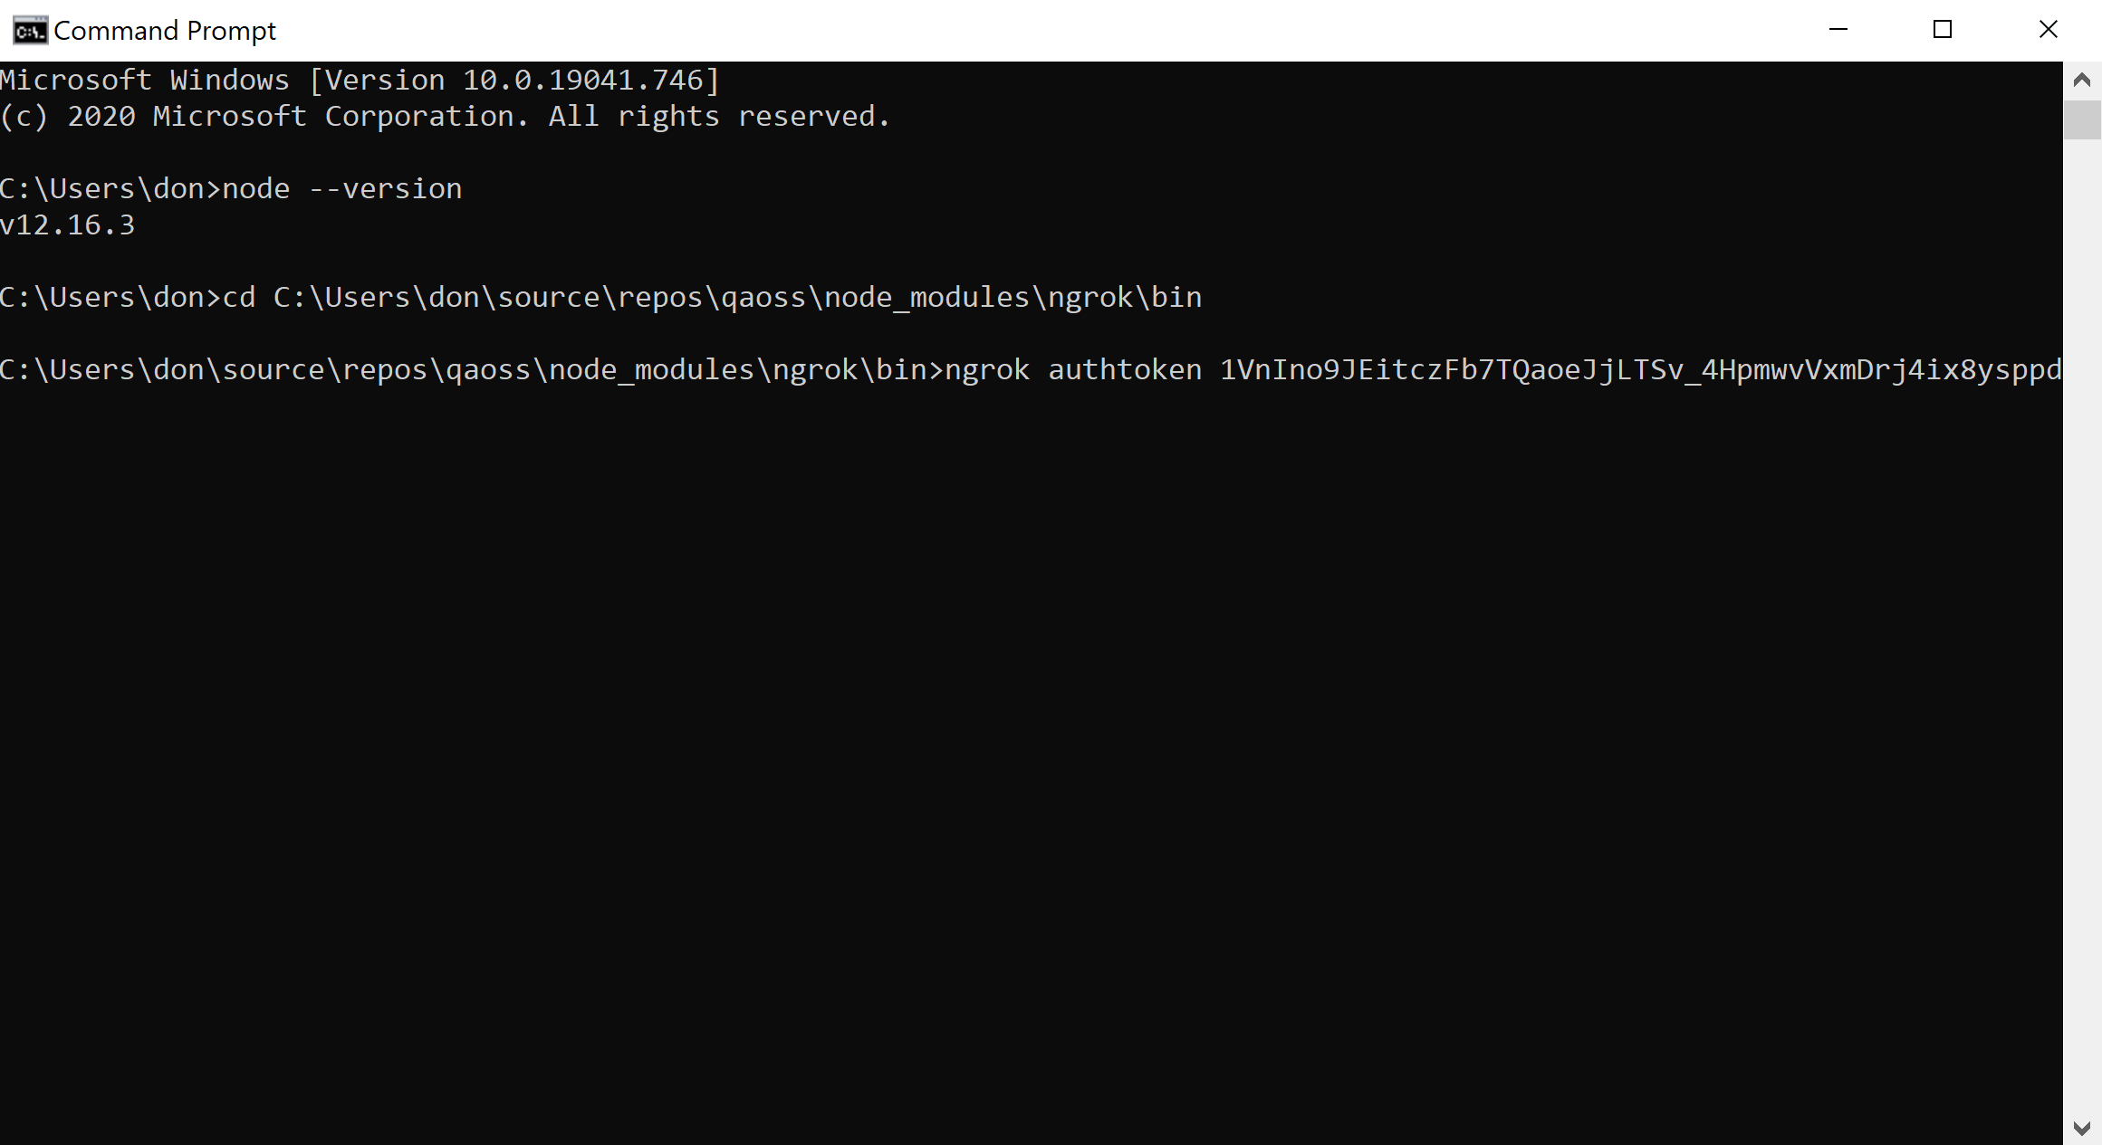
Run the following command
C:\(folder where you copied qaoss files)\qaoss\node_modules\ngrok\bin>ngrok authtoken (your authentication token here)
You should see the message: Authtoken saved to configuration file: ngrok.yml

Slide 10
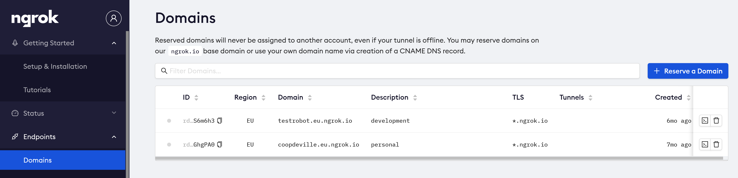
Log into your account at ngrok and go to "endpoints" --> "domains" and create a custom domain for yourself.
Eg; "RockAndRoll" or anything you want.
You can create two domains if you’d like. Use one for a personal Qaoss timeline and one for a Group timeline.

Slide 11
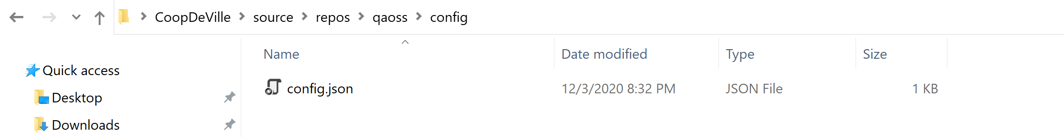
On your computer in the config folder under the qaoss folder right click and open the config.json with a text editor like Notepad. Then add your new custom domain name to the “ngrok_url” parameter and pick an alias for your timeline. Make sure they are in double quotes.
{
"port": "3000",
"group": "0“,
"ngrok_url": “RockAndRoll”, ←Make sure it’s in double quotes
"alias":“Elvis“
}

Slide 12
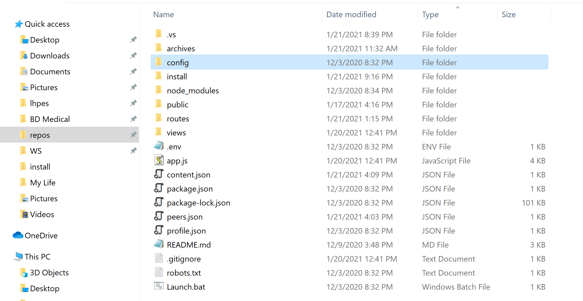
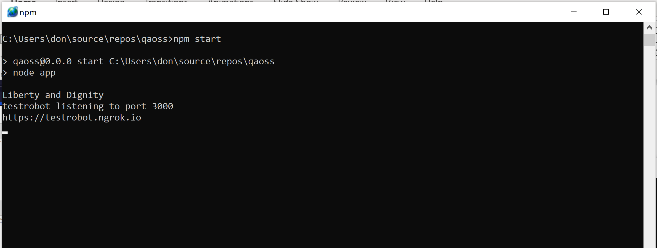
Double click the Launch.bat file in the qaoss folder. Your personal social media website should be up and running.

Slide 13
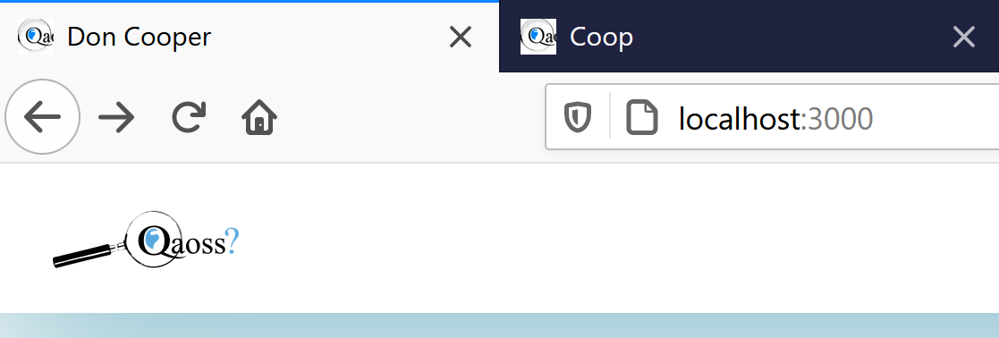
Open a browser – Firefox, Edge or Chrome -- and type localhost:3000 in the address bar to begin testing.

Slide 14
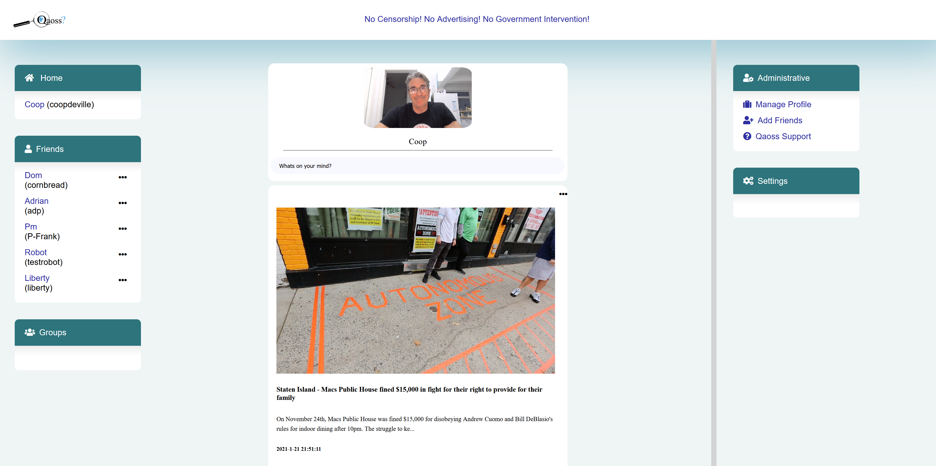

Slide 15
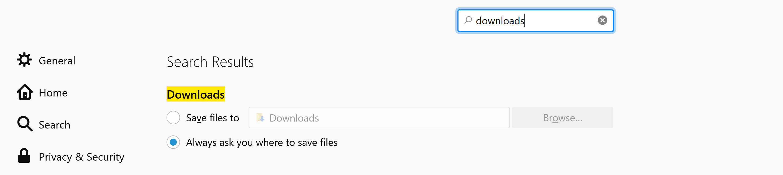
Go to your browsers “Settings” and configure “Downloads” to ask where to save each time.
Consult your browsers help to find out how to configure download settings. This is needed for sharing posts from other users. Since all your content is saved on your computer, you save shared posts on your computer as well.

